Slide 1
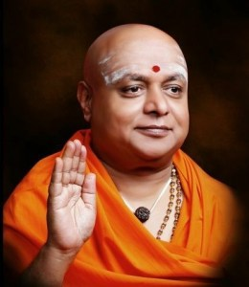
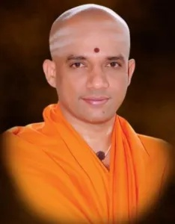
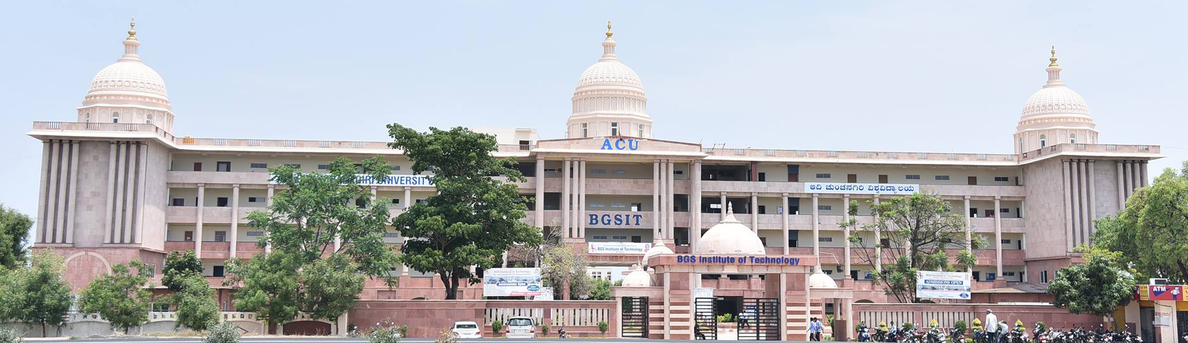
||JAI SRI GURUDEV||
SRI ADICHUNCHANAGIRI SHIKSHANA TRUST ®
BGS INSTITUTE OF TECHNOLOGY, BG NAGARA
DEPARTMENT OF CIVIL ENGINEERING
HEARTY WELCOME TO
NBA CHAIRMAN & COMMITTEE MEMBERS
Dr. T.MAHADEVAIAH
Professor and HOD-CED

Slide 2
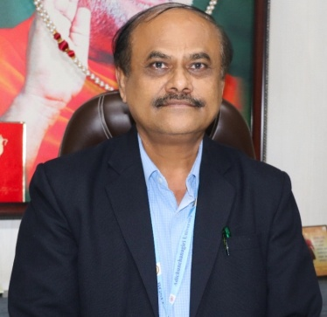
Introduction
QUALIFICATION | B.E (Civil), 1985 M Tech (Remote sensing), 1992 PhD (2007) Anna University, Chennai ‘Integrated study of Chitravathi watershed, Karnataka, India using Remote Sensing and GIS’
REPORTING DATE | 16.01.2013
EXPERIENCE | Teaching - 33 Yrs, Others – 2 yrs
PATENTS | 04
PUBLICATIONS | 08
CONFERENCES | 06
GUEST LECTURES | 02
MEMBERSHIP | MISTE - LM 4808, ISC – L38391, FIE – F-120874-4
GRANTS RECEIVED | Rs. 5 Lakhs from AICTE Rs. 30 Lakhs from VGST under CISEE Scheme
UNIVERSITY ASSIGNMENTS | Board of Examiner - VTU Chairman - Board of Studies - ACU
RESEARCH SCHOLORS | 04
HOD Profile
Department Profile
Dr. T.MAHADEVAIAH
M Tech, Ph.D
Professor & Head
Department of Civil Engineering
BGSIT , B G NAGARA
Department achievements
Faculty
achievements
hodcv@bgsit.ac.in
mahadevaiaht@gmail.com
Students
achievements
9900250327

Slide 3
Introduction
Department Establishment | 2009-10
Approved by | AICTE, New Delhi.
Recognized by | Government of Karnataka
Affiliation | Visvesvaraya Technological University , Belagavi.
Intake | 60
TEACHING STAFF DETAILS
HOD Profile
 | 2020-21 | 2019-20 | 2018-19
No. of Faculty | 15 | 16 | 14
No. of Professors | 03 | 02 | 02
No. of Associate Professors | 02 | 02 | 02
No. of Assistant Professors | 10 | 12 | 10
No. of Ph.D. | 03 | 02 | 02
Department Profile
Department achievements
INFRASTRUCTURE FACILITIES
Class Rooms | 05 | Staff Rooms | 03
Seminar hall | 01 | Dept Library | 01
Laboratories | 07 | Model Room | 01
HOD Chamber | 01 | Project lab | 01
NON TEACHING STAFF DETAILS
Faculty
achievements
No. of Lab Instructors | 04
No. of Attender/Helper | 01
Students
achievements

Slide 4
Department Level Achievements
Four patents have been filed by the Department.
Department has MOUs with
  Sir M V Institute of Engineering Skills, Bengaluru,
  Agrima Roofs & Facade system, Bengaluru
  Association of Consulting Civil Engineers (India)
  Naipunya Engineering Consultancy, Mysuru
  Prayojana construction Management Training Institute, Bangalore.
Fourteen research scholars are pursuing PhD in Departmental Research Centre, four scholars have completed Comprehensive Viva Voce.
Well established R & D centre in the department. Obtained sponsored research to the amount of Rs. 30Lakh.
Organized a National Conference on “EMERGING TRENDS IN CIVIL ENGINEERING” - NCETCE -2018 on 19th May- 2018.
Staff members have published more than 50 number of papers in Journals & Conferences.
Average Professional Experience of faculties is 10+ years.
Retention of faculties is more than 88%.
50% of Faculty Members are pursuing Ph.D.
50% of Faculty Members have completed SWAYAM Course, Aiming for 100%.
HOD Profile
Department Profile
Department achievements
Faculty
achievements
Students
achievements

Slide 5
Faculty Level Achievements
Dr. B K Narendra :
  Member of the Section managing committee ,ISTE , Karnataka 2020 to 2024.
  IEAE Reviewer and Subject Expert for the selection of Professor/ Associate Professor.
  Awarded with Principal of the year 2018 by IEAE
  Honoured for Excellence in the Field of Teaching, Research and Publications -2018
  LIC committee member for the academic year 2016-17 at VTU.
  Served as President, Rotary club B G Nagara 2017-18
  Appreciation for outstanding contribution in educational and research domain
Dr. T Mahadevaiah :
  Served as President, Rotary club B G Nagara 2018-19
  BOE for Civil Board at VTU for the year 2016-17
  Resource person for delivering Technical talks
H J Puttabasavegowda :
  Resource person for delivering Technical talks
  Manjula K :
  Submitted book chapter AT WILEY - SP, USA
Mahalingegowda H R :
  Submitted book chapter at WILEY - SP, USA
  Judge for FIESTA’19
Uma A :
  Participated in NSS Special Camp
HOD Profile
Department Profile
Department achievements
Faculty
achievements
Students
achievements

Slide 6
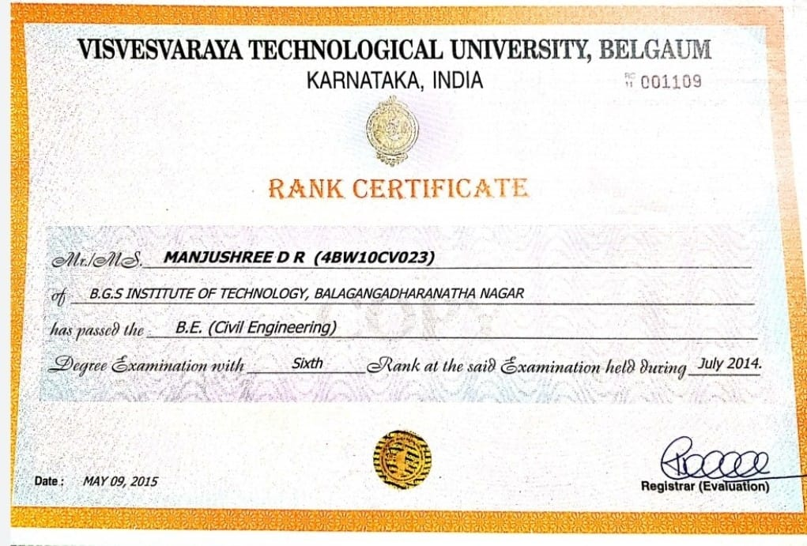
Student Level Achievements
Manjushree D R (4BW10CV023):
  Secured VTU 6th rank in the year 2014.
Sachin J A (4BW14CV044):
  Secured 5th place and 3rd place in VTU inter colligate athletic meet.
Kishan S & Arun M:
  Won 2nd prize at JVTM in the year 2017-18.
Arun M:
  Won 1st prize in Technical fest (Innerve 17)..
Jeevan kumar P & Rohith B R:
  Won 2nd prize at JVTM in the year 2018-19.
  Won 2nd prize in Technical fest (Modex 2018).
Varun shankar C P, Chandrakanth J, Manjunath J H, Nandish M S, Uday shankar C P , Nithingowda M K :
  Runner up for Kabbadi tournament organized by VTU in the year 2017.
Purushotham (19CVE032):
  Won II Place in long jump event Men U-23, organized by Karnataka state junior athletics championship in the year 2021.
HOD Profile
Department Profile
Department achievements
Faculty
achievements
Students
achievements

Slide 7
Criterion-1: Vision, Mission and PEO
Vision
BGSIT is committed to the cause of creating tomorrow’s engineers by providing quality education and inculcating ethical values.
Mission
Imparting quality technical education by nurturing a conducive learning environment.
Offering professional training to meet industry requirements.
Providing education with a moral - cultural base and spiritual touch.
Institute
Vision Mission
PEO
Vision
Producing technically competent and Environmental friendly Civil Engineering Professionals to cope with the societal challenges.
Mission
Imparting quality education and professional ethics by proficient faculty.
Providing infrastructure to meet the requirements of curriculum, research and consultancy.
Motivating towards higher education and entrepreneurship.
Promoting Interaction with design and construction industries.
Department

Slide 8
Criterion-1: Vision, Mission and PEO
PROGRAM EDUCATIONAL OBJECTIVES (PEOs)
Vision Mission
PEO 1: Graduates will be pursuing successful career & higher education.
PEO 2: Graduates will be able to design safe, economical & sustainable civil engineering structures conforming to standards.
PEO 3: Graduates will display professional ethics to work in a team & lead the team by effectively communicating the ideas.
PEO 4: Graduates will practice lifelong learning.
PEO

Slide 9
VTU SCHEMES OF STUDY
Criterion-2 : Program Curriculum & TLP
Curriculum
Scheme | Year of Study | Semester | Evaluation
2010 | 2013-17 | Graduated | 100 (SEE) + 25 (CIE)
2010 | 2014-18
2015 | 2015-19 | Graduated | 80 (SEE) + 20 (CIE)
2015 | 2016-20
2017 | 2017-21 | VIII | 60 (SEE) + 40 (CIE)
2018 | 2018-22 | VII
2018 | 2019-23 | IV
2018 | 2020-24 | II
Curriculum Compliance
Teaching Learning Process

Slide 10
Criterion-2 : Program Curriculum & TLP
Process for Identifying Curricular Gaps
Course Allotment
Curriculum
Course Allotted faculty describe the course outcome
NBA
Program Outcome
CO-PO and CO-PSO Mapping done by the course coordinator & average is calculated
Program Specific Outcome approved by DAB committee
Curriculum Compliance
Gaps identified based on CO PO matrix for 2015 scheme
PO’S & PSO’S | PO7 | PO8 | PO9 | PO10 | PO11 | PO12
GAP | Yes | Yes | Yes | Yes | Yes | Yes
If approved by the Module Coordinator / Reviewer & HOD
NO
Teaching Learning Process
YES
Consolidate the CO-PO/PSO mapping for all courses
Calculate sum of CO-PO / PSO mapping (S)
Total number of courses addressing each PO/PSO (T)
% of PO’s / PSO’s Correlation >= 20
[G = (S / T) * 100]
Gap exists
Action Taken
No Gap

Slide 11
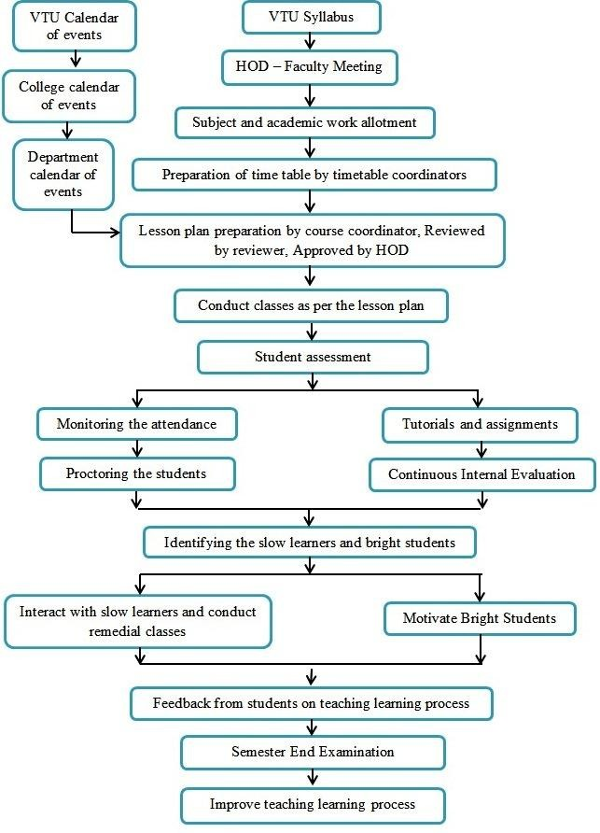
Criterion-2 : Program Curriculum & TLP
Curriculum
Curriculum Compliance
Process of
Teaching
and
Learning
Teaching Learning Process

Slide 12

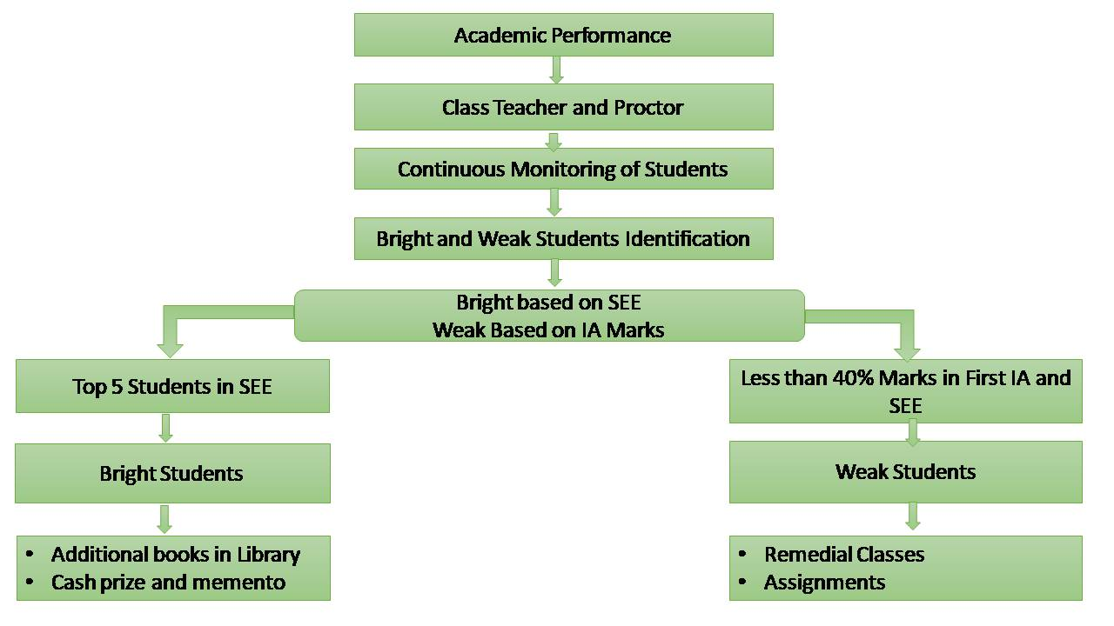









Methodology to Identify Slow Learners &
Bright Students
Criterion-2 : Program Curriculum & TLP
Process Of Conducting Internal Assessment
College calendar of events
Curriculum
Test time table preparation
Invigilation work allotment
Curriculum Compliance
Test question paper and scheme of evaluation prepared by course coordinator
Teaching Learning Process
Reviewed by HOD: Verified for format, syllabus coverage and blooms taxonomy
Yes
If correction
No
Approved by HOD
Submitted to coordinator for conduction of test
Test papers are evaluated according to scheme
Measurement analysis

Slide 13
Program Specific Outcomes(PSOs)
Criterion-3 : Course Outcome, PO & PSO
PSO
PSO 1
Graduates will be able to analyze, design and execute the civil engineering structures effectively for the sustainable development.
PSO 2
Graduates will acquire critical thinking abilities and technical skills for the usage of modern tools in development of civil engineering structures.
PSO 3
Graduates will be able to get opportunities for their professional growth, demonstrate communication and aptitude skills to face the challenges and needs of our society.
Process to define CO
CO-PO/PSO Mapping
Process for CO Attainment
Process for PO/PSO Attainment
CO-PO/PSO Attainment

Slide 14
Criterion-3 : Course Outcome, PO & PSO
University Curriculum
PSO
Course Co-ordinator
Process to define CO
Define Course Outcomes
CO-PO/PSO Mapping
Module Co-ordinator
PAC
Approval
Process for CO Attainment
Process to define the Course Outcomes
No
Process for PO/PSO Attainment
Yes
CO-PO/PSO Attainment
Approved Course Outcomes

Slide 15
Criterion-3 : Course Outcome, PO & PSO
CO, PO and PSO Mapping Course Code: 15C202 Course Name: Strength of Materials [15CV32]
CO1: Analyze the stress and strain behavior of materials.
CO2: Determine the behavior and strength of structural elements under the action of compound stresses and thus perceive the failure concepts.
CO3: Evaluate the shear and flexure forces in determinate beams for various combinations of loads and supporting conditions
CO4: Design the members subjected to torsion.
CO5: Analyze and design the structural elements such as columns and struts.
PSO
Process to define CO
CO-PO/PSO Mapping
Process for CO Attainment
CO/PO | PO1 | PO2 | PO3 | PO4 | PO5 | PO6 | PO7 | PO8 | PO9 | PO10 | PO11 | PO12 | PSO1 | PSO2 | PSO3
15C202.1 | 3 | 1 | 1 | - | - | 1 | - | - | - | - | - | 1 | 2 | 1 | 1
15C202.2 | 3 | 2 | 1 | 2 | - | 1 | - | - | - | - | - | 1 | 3 | 2 | 1
15C202.3 | 3 | 3 | 2 | 2 | - | 1 | - | - | - | - | - | 1 | 3 | 2 | 1
15C202.4 | 3 | 3 | 2 | 2 | - | 1 | - | - | - | - | - | 1 | 3 | 2 | 1
15C202.5 | 3 | 3 | 2 | 2 | - | 1 | - | - | - | - | - | 1 | 3 | 2 | 1
15C202 | 3 | 2.4 | 1.6 | 2 | - | 1 | - | - | - | - | - | 1 | 2.8 | 1.8 | 1
Process for PO/PSO Attainment
CO-PO/PSO Attainment

Slide 16
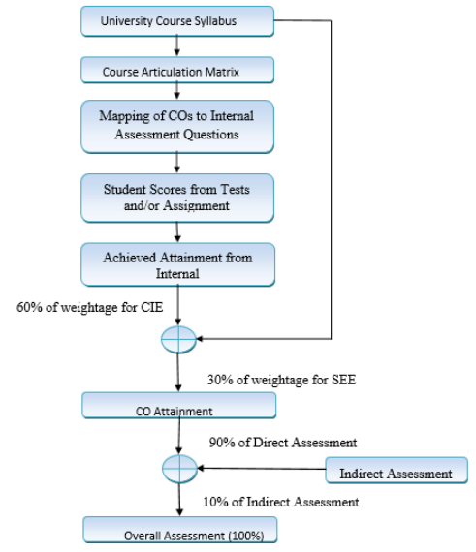
Criterion-3 : Course Outcome, PO & PSO
Assessment process for Course Outcomes Evaluation
PSO
Process to define CO
CO-PO/PSO Mapping
Process for CO Attainment
Process for PO/PSO Attainment
CO-PO/PSO Attainment

Slide 17
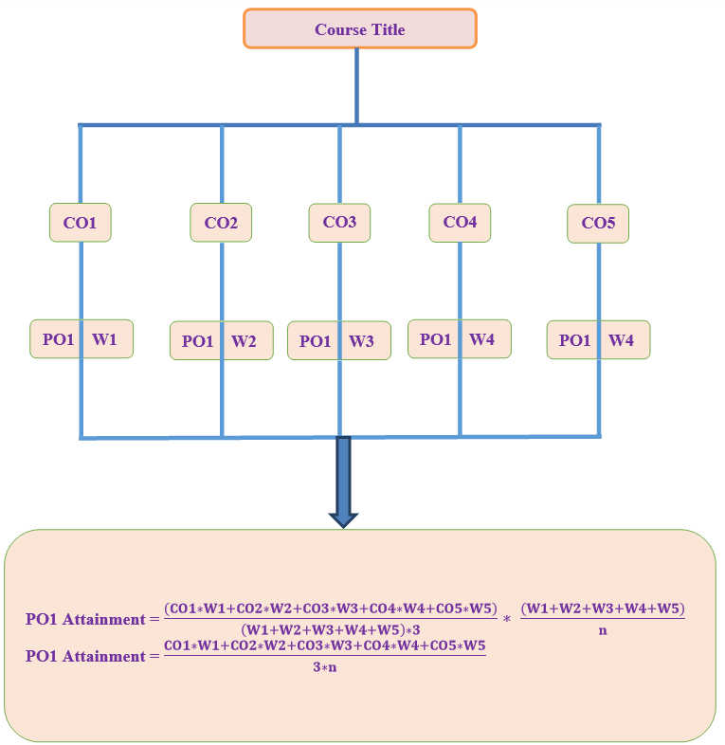
Criterion-3 : Course Outcome, PO & PSO
Processes used for measuring the attainment of each PO
and PSO
PSO
Process to define CO
CO-PO/PSO Mapping
Process for CO Attainment
Process for PO/PSO Attainment
CO-PO/PSO Attainment

Slide 18
Criterion-3 : Course Outcome, PO & PSO
Test # |  |  | TEST-1
Q # |  |  | Q1 |  | Q2 |  | Q3 |  | Q4
CO # |  |  | CO1 | CO2 | CO1 | CO1 | CO2 | CO2 | CO1 | CO3
Sub Q # |  |  | 1.A | 1.B | 2.A | 2.B | 3.A | 3.B | 4.A | 4.B
Max. Marks |  |  | 10 | 5 | 10 | 5 | 10 | 5 | 10 | 5
1 | ABHILASHA C.Y | 4BW15CV001 | 9 | 4 |  |  | 10 | 3
2 | AKASH G.C | 4BW15CV003 |  |  | 3 | 3 | 3
3 | APOORVA P | 4BW15CV004 | 9 | 3 |  |  | 9 | 4
4 | CHAITHRA B N | 4BW15CV006 |  |  | 10 | 5 | 9 | 5
5 | CHITRA SMITHA S | 4BW15CV008 | 6 |  | 3 | 4 | 8 | 3
Assignment | End Term |  |  |  | Course End Survey
5 | Internal | Total | External | Total | Q1 | Q2 | Q3 | Q4
 | 15 | 20 | 80 | 100 | CO1 | CO2 | CO3 | CO4
5 | 12 | 17 | 58 | 75 | 3 | 3 | 3 | 2
5 | 8 | 13 | 38 | 51 | 3 | 3 | 3 | 2
5 | 11 | 16 | 39 | 55 | 2 | 3 | 3 | 3
5 | 15 | 20 | 71 | 91 | 3 | 3 | 3 | 2
5 | 10 | 15 | 50 | 65 | 2 | 3 | 2 | 3
PSO
Process to define CO
CO-PO/PSO Mapping
IF (%>=90,Level 3, >=80,2, >=70,1,<70,0)
(Obtained Marks / Max. Marks) * 100
IF (%>=70,Level 3, >=60,2, >=50,1,<50,0)
IF (%>=70,Level 3, >=60,2, >=50,1,<50,0)
Process for CO Attainment
Converting to Levels
3 | 3 | 0 | 0 | 3 | 2 | 0 | 0
0 | 0 | 0 | 2 | 0 | 0 | 0 | 0
3 | 2 | 0 | 0 | 3 | 3 | 0 | 0
0 | 0 | 3 | 3 | 3 | 3 | 0 | 0
2 | 0 | 0 | 3 | 3 | 2 | 0 | 0
8 | 5 | 3 | 8 | 12 | 10 | 0 | 0
Converting to Levels
Assignment |  |  | SEE
5 | 100 | 3 | 58 | 73 | 3
5 | 100 | 3 | 38 | 48 | 0
5 | 100 | 3 | 39 | 49 | 0
5 | 100 | 3 | 71 | 89 | 3
5 | 100 | 3 | 50 | 63 | 2
 |  | 15 |  |  | 8
Converting to Percentage
90 | 80 | 0 | 0 | 100 | 60 | 0 | 0
0 | 0 | 30 | 60 | 30 | 0 | 0 | 0
90 | 60 | 0 | 0 | 90 | 80 | 0 | 0
0 | 0 | 100 | 100 | 90 | 100 | 0 | 0
60 | 0 | 30 | 80 | 80 | 60 | 0 | 0
Process for PO/PSO Attainment
SUM
SUM
CO-PO/PSO Attainment
Levels | 8 | 5 | 3 | 8 | 12 | 10 | 0 | 0
No. of Students Attended | 3 | 2 | 3 | 3 | 5 | 4 | 0 | 0

Slide 19
Criterion-3 : Course Outcome, PO & PSO
CO Attainment Table
CIE=0.9*2.11+0.1*3
PSO
 |  |  | 90 | 10 | 60 | 30 | 10
 | LEVELS | STUD | IA | ASS | CIE | SEE | CES | ATTIN
CO1 | 19 | 9 | 2.11 | 3 | 2.19 | 2.67 | 2.60 | 2.37
CO2 | 27 | 11 | 2.45 | 3 | 2.50 | 2.67 | 3.00 | 2.60
CO3 | 0 | 0 | 0 | 3 | 0.3 | 2.67 | 2.80 | 1.26
CO4 | 0 | 0 | 0 | 3 | 0.3 | 2.67 | 2.40 | 1.22
Attainment =0.6*2.19+0.3*2.67+0.1*2.40
PO = CO Attained value * CO PO Matrix value
Process to define CO
CO - PO/PSO - MATRIX
CO/PO/PSO | PO1 | PO2 | PO3 | PO4 | PO5 | PO6 | PO7 | PO8 | PO9 | PO10 | PO11 | PO12 | PSO1 | PSO2 | PSO3
15C305.1 | 3 | 1 | - | 2 | 3 | 3 | 3 | 1 | 1 | 2 | 1 | 1 | 1 | 1 | 1
15C305.2 | 1 | 1 | 2 | 1 | 1 | 3 | 3 | 1 | 1 | 2 | 1 | 1 | 2 | 2 | 1
15C305.3 | 3 | 3 | 2 | 3 | 1 | 3 | 3 | 1 | - | 1 | - | - | 2 | 1 | 1
15C305.4 | 2 | 3 | 3 | 3 | 1 | 3 | 3 | 1 | - | - | - | - | 3 | 2 | 1
15C305 | 2.25 | 2 | 2.33 | 2.25 | 1.5 | 3 | 3 | 1 | 1 | 1.57 | 1 | 1 | 2 | 1.67 | 1
CO - PO/PSO - ATTAINMENT
CO ATTAINED VALUE | PO1 | PO2 | PO3 | PO4 | PO5 | PO6 | PO7 | PO8 | PO9 | PO10 | PO11 | PO12 | PSO1 | PSO2 | PSO3
2.37 | 7.11 | 2.37 |  | 4.74 | 7.11 | 7.11 | 7.11 | 2.37 | 2.37 | 4.74 | 2.37 | 2.37 | 2.37 | 2.37 | 2.37
2.60 | 2.60 | 2.60 | 5.20 | 2.60 | 2.60 | 7.80 | 7.80 | 2.60 | 2.60 | 5.20 | 2.60 | 2.60 | 5.20 | 5.20 | 2.60
1.26 | 3.78 | 3.78 | 2.52 | 3.78 | 1.26 | 3.78 | 3.78 | 1.26 |  | 1.26 |  |  | 2.52 | 1.26 | 1.26
1.22 | 2.44 | 3.66 | 3.66 | 3.66 | 1.22 | 3.66 | 3.66 | 1.22 |  |  |  |  | 3.66 | 2.44 | 1.22
SUM | 15.93 | 12.41 | 11.38 | 14.78 | 12.19 | 22.35 | 22.35 | 7.45 | 4.97 | 11.20 | 4.97 | 4.97 | 13.75 | 11.27 | 7.45
ATTAINED | 1.33 | 1.03 | 1.26 | 1.23 | 1.02 | 1.86 | 1.86 | 0.62 | 0.83 | 1.24 | 0.83 | 0.41 | 1.15 | 0.94 | 0.62
CO-PO/PSO Mapping
Process for CO Attainment
Process for PO/PSO Attainment
CO-PO/PSO Attainment

Slide 20
Criterion-3 : Course Outcome, PO & PSO
Attainment of CO-PO & PSO for AY 2016-20
2016-20 | PO1 | PO2 | PO3 | PO4 | PO5 | PO6 | PO7 | PO8 | PO9 | PO10 | PO11 | PO12 | PSO1 | PSO2 | PSO3
Mapped Value | 2.74 | 2.39 | 2.11 | 1.83 | 1.99 | 1.61 | 1.47 | 1.52 | 1.7 | 1.83 | 1.82 | 1.52 | 2.25 | 1.84 | 1.63
Target( %) | 80 | 80 | 80 | 80 | 80 | 80 | 80 | 80 | 80 | 80 | 80 | 80 | 80 | 80 | 80
Attained values | 2 | 1.81 | 1.72 | 1.6 | 1.68 | 1.47 | 1.42 | 1.46 | 1.51 | 1.62 | 1.58 | 1.38 | 1.74 | 1.56 | 1.43
Attained (%) | 73 | 76 | 81 | 87 | 85 | 91 | 96 | 96 | 89 | 89 | 87 | 91 | 77 | 85 | 88
PSO
Process to define CO
CO-PO/PSO Mapping
PO AND PSO ATTAINMENT
Process for CO Attainment
Process for PO/PSO Attainment
CO-PO/PSO Attainment

Slide 21
STUDENTS ENROLLMENT
Criterion 4: Student’s Performance
Item | CAY 2020-21 | CAY m1 2019-20 | CAYm2 2018-19 | CAYm3 2017-18 | CAYm4 2016-17 | CAYm5 2015-16 | CAYm6 2014-15 | CAYm7 2013-14
Sanctioned intake of program (N) | 60 | 60 | 60 | 60 | 60 | 60 | 60 | 60
Total number of students admitted in the first year (N1) | 30 | 45 | 60 | 58 | 56 | 57 | 55 | 58
Number of students admitted in the 2nd year via lateral Entry (N2) | 00 | 15 | 02 | 16 | 18 | 15 | 20 | 12
Separate division of students if applicable (N3) | 00 | 00 | 02 | 04 | 03 | 03 | 03 | 03
Total Number of students admitted in the program (N1+N2+N3) | 30 | 60 | 64 | 78 | 77 | 75 | 78 | 73
Enrollment Ratio
Success rate
Academic performance
After graduation
 | CAY 2020-21 | CAYm1 2019-20 | CAYm2 2018-19
N | 60 | 60 | 60
N₁ | 30 | 45 | 60
Enrolment Ratio = N₁/N | 0.50 | 0.75 | 1.00
Avg Enrolment Ratio | 0.75
News letter
Students activities

Slide 22
Criterion 4: Student’s Performance
Success Rate of Students within Stipulated Period of Study
Enrolment Ratio
Success rate
Academic performance
Average SI = 0.32
After graduation
Average SI = 0.75
Success rate without backlogs =0.32*25 = 8
News letter
Success rate with & without backlogs=0.75*15 = 11.25
Students activities

Slide 23
Criterion 4: Student’s Performance
ACADEMIC PERFORMANCE IN THIRD YEAR
Enrolment Ratio
Academic Performance | 2019-20 (2017 Batch) | 2018-19 (2016Batch) | 2017-18 (2015Batch)
Mean of CGPA or Mean Percentage of all successful students(X) | 7.18 | 6.70 | 6.73
Total no. of successful students (Y) | 66 | 57 | 55
Total no. of students appeared in the examination (Z) | 66 | 57 | 56
API = X* (Y/Z) | 7.18 | 6.70 | 6.60
Average API = (AP1 + AP2 + AP3)/3 | 6.83
Academic performance level= 1.5 * Average API =1.5*6.83=10.25
Success rate
Academic performance
ACADEMIC PERFORMANCE IN SECOND YEAR
Academic Performance | 2019-20 (2018 Batch) | 2018-19 (2017 Batch) | 2017-18 (2016 Batch)
Mean of CGPA or Mean Percentage of all successful students(X) | 6.87 | 6.16 | 5.34
Total no. of successful students (Y) | 64 | 66 | 57
Total no. of students appeared in the examination (Z) | 64 | 68 | 65
API = X* (Y/Z) | 6.87 | 5.97 | 4.64
Average API = (AP1 + AP2 + AP3)/3 | 5.83
Academic performance level= 1.5 * Average API = 1.5* 5.83 =8.74
After graduation
News letter
Students activities

Slide 24
Criterion 4: Student’s Performance
Item | CAYm1 2019-20 | CAYm2 2018-19 | CAYm3 2017-18
Total No. of Final Year Students (N) | 67 | 55 | 62
No. of Students placed in companies or Government Sector (x) | 28 | 28 | 30
No. of students admitted to higher studies with valid qualifying score (GATE or equivalent state or National level Tests, GRE,GMAT etc.) (y) | 06 | 00 | 04
No. of students turned entrepreneur in engineering/technology (z) | 00 | 01 | 02
x + y + z = | 34 | 29 | 36
Placement Index: (x + y + z) / N | 0.50 | 0.53 | 0.58
Average placement = (P1 + P2 +P3) / 3 | 0.55
Placement, Higher studies and Entrepreneurship
Enrollment Ratio
Success rate
Academic performance
After graduation
News letter
Assessment Points = 21.46
Students activities

Slide 25
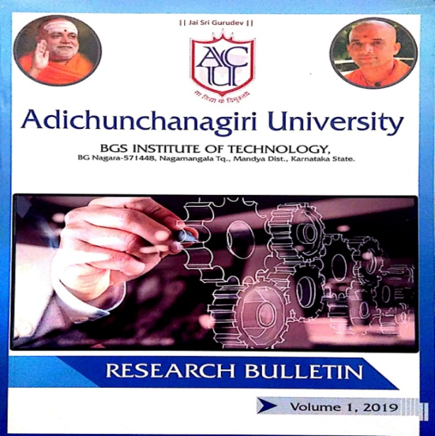
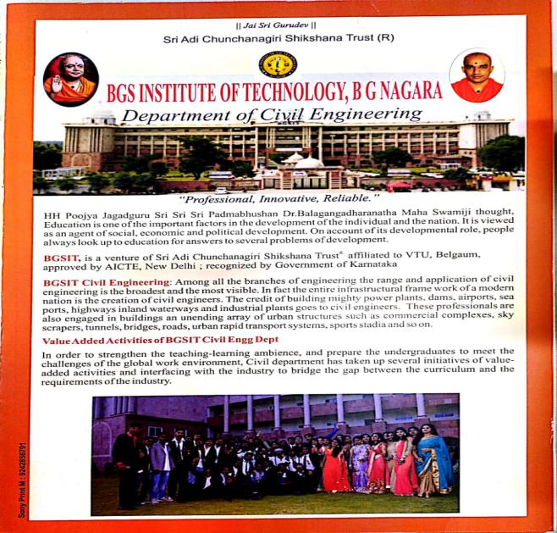

Criterion 4: Student’s Performance
News Letter and Research Bulletin
Enrollment Ratio
Success rate
Academic performance
After graduation
News letter
Students activities

Slide 26
Criterion 4: Student’s Performance
Students Activities
Enrollment Ratio
Organizing Conference, Technical Talks and Workshops.
Professional Societies – IGBC , IEI , ACCE
Project Exhibition.
Participation in Hackathons.
Students participation in inter and intra institutions activities.
Success rate
Academic performance
After graduation
News letter
Students activities

Slide 27
Criterion-5 : Faculty Information & Contribution
Sl. No. | Name of the Faculty | Qualification | Designation | Joining Date | Specialization
1 | Dr. B K Narendra | Ph.D | Prof & Principal | 30/01/2008 | Structural Engineering
2 | Dr. T Mahadevaiah | Ph.D | Prof & Head | 16/01/2013 | Remote Sensing & GIS
3 | Mr. ShankaralingeGowda G K | M.Tech | Associate Prof. | 01/02/2007 | CADSS
4 | Dr. H J Puttabasavegowda | PhD | Professor | 01/09/2020 | Geotechnical Engineering
5 | Mr. Shivakumar G B | M.Tech | Associate Prof. | 01/09/2005 | Environmental Engineering
6 | Mrs. Shruthi R | M.Tech (PhD) | Asst. Prof. | 20/07/2011 | Environmental Engineering
7 | Mr. Sunil R | M.Tech (PhD) | Asst. Prof. | 01/08/2012 | Construction Technology
8 | Mrs. Kavya B.M | M.Tech (PhD) | Asst. Prof. | 01/08/2012 | Hydraulics
9 | Mrs. Manjula K | M.Tech (PhD) | Asst. Prof. | 26/07/2010 | Structural Engineering
10 | Mr. Mahalingegowda H R | M.Tech (PhD) | Asst. Prof. | 08/02/2016 | CAD Structures
11 | Mr. Gagan Krishna R R | M.Tech | Asst. Prof. | 01/08/2017 | Structural Engineering
12 | Mr. Deviprasad | M.Tech | Asst. Prof. | 01/08/2017 | CAD Structures
13 | Mr. Shivaprathap H K | M.Tech (PhD) | Asst. Prof. | 01/08/2018 | Structural Engineering
14 | Mrs. Gomathi R | M.Tech (PhD) | Asst. Prof. | 01/08/2019 | Infrastructure Engg & Management
15 | Ms. Uma A | M.Tech | Asst. Prof. | 01/08/2019 | Structural Engineering
Faculty List
SFR & Qualification
FCP
Retention
Innovative Tools
FDP
R & D
Self appraisal

Slide 28
Criterion-5 : Faculty Information & Contribution
Faculty Qualification
Year | CAY (2020-21) | CAYm1 (2019-20) | CAYm2 (2018-19)
Total No. of Students in the Department(S) | 249 | 252 | 265
No. of Faculty in the Department (F) | 14 | 15 | 13
Student Faculty Ratio (SFR) | 17.78 | 16.80 | 20.38
Average SFR | 18.32
Faculty List
 | X | Y | F | FQ = 2.5 x [(10X + 4Y) / F )]
2020-21 (CAY) | 03 | 12 | 12 | 16.25
2019-20 (CAYm1) | 02 | 13 | 12 | 15.00
2018-19 (CAYm2) | 02 | 11 | 13 | 12.31
Average Assessment |  |  |  | 14.52
SFR & Qualification
FCP
Retention
Innovative Tools
FDP
Where,
X is no. of regular faculty with Ph.D
Y is no. of regular faculty with MTech.,
F is no. of regular faculty required to comply 20:1 Faculty Student ratio
R & D
Student Faculty Ratio | 18.32
Self appraisal

Slide 29
Criterion-5 : Faculty Information & Contribution
Academic Year | Professors | Associate Professors | Assistant Professors
CAY (2020-21) | 3 | 0 | 12
CAYm1 (2019-20) | 2 | 0 | 14
CAYm2 (2018-19) | 2 | 0 | 12
Faculty List
SFR & Qualification
Faculty Retention
FCP
Retention
Description | 2020-21 | 2019-20
No of Faculty Retained | 11 | 12
No. of faculty in base year CAYm2 2018-19 | 13 | 13
% of Faculty Retained | 85 | 92
Average Percentage Faculty Retention | 88.50
Innovative Tools
Faculty Cadre Proportion
FDP
R & D
Self appraisal

Slide 30
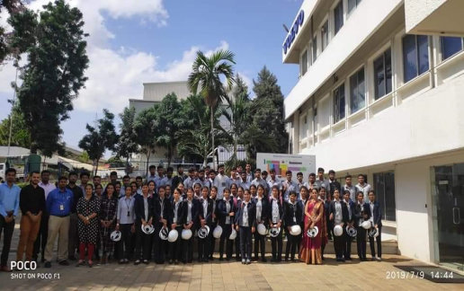
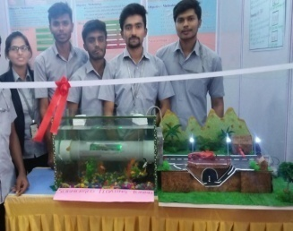
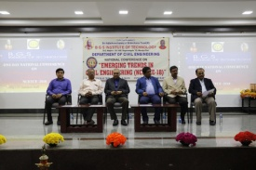
Criterion-5 : Faculty Information & Contribution
Innovative tools used by the Faculty in Teaching and Learning Process
Faculty List
Sl. No. | Method | Content Delivery | Facility
1 | Class Room Teaching, Student Centric activities | Power Point Presentations | ICT Enabled class room
 |  | Seminars
 |  | Group Discussions
 |  | Peer Learning
 |  | Participative Learning
2 | E-Learning | On-line Journals | Digital Library, Internet, You-tube, Swayam, MOOCS, and Science Direct , webinars etc.
 |  | Videos, Animations
 |  | On-line Lectures
 |  | NPTEL Videos
 |  | Webinars
3 | Evaluation, Assessment , Improvement | Internal Assessments | Off line
 |  | Assignments
4 | Computer Assisted Learning | AutoCAD | Softwares
 |  | StaadPro
 |  | ETABS
SFR & Qualification
FCP
Retention
2016-2020 batch students visited
Volvo Company, Peenya Bengaluru, 09-07-2019
Innovative Tools
FDP
R & D
International conference on
“EMERGING TRENDS IN CIVIL ENGINEERING NCETCE -2018”
on 19th May- 2018
Self appraisal

Slide 31
Criterion-5 : Faculty Information & Contribution
PARTICIPATION OF FACULTY MEMBERS IN FDP / TRAINING ACTIVITIES/STTP
Faculty List
SFR & Qualification
Year | Faculty Deputed
2019-20 | 7
2018-19 | 9
2017-18 | 8
FCP
Retention
Innovative Tools
FDP
R & D
Self appraisal

Slide 32
Criterion-5 : Faculty Information & Contribution
R & D Center establishment year | No of research guide | No of scholars registered | PhD Pursuing in the department | Patents
2014 | 02 | 12 | 06 | 04
Faculty List
SFR & Qualification
Patents
Sl. No. | Applicant Name | Application No. | Date of filling | Title of Invention
1 | Dr. B K Narendra Dr, T Mahadevaiah | 16550288 | 26.08.2019 | Shock and vibration isolation system for payloads using Stewart platform
2 | Dr. B K Narendra Dr, T Mahadevaiah | 201941042125 | 17.10.2019 | Eco-friendly geopolymer concrete added with fibre an a method of preparation for the same
3 | Dr. B K Narendra Dr, T Mahadevaiah | 201941051093 | 10.12.2019 | Method for Rain runoff analysis to estimate a land cover
4 | Dr. B K Narendra Dr, T Mahadevaiah | 201941053042 | 20.12.2019 | Submerged tunnel system for transportation
FCP
Retention
MOOC Courses
Year | No. of Faculty
2020-21 | 03
2019-20 | 07
2018-19 | 03
Innovative Tools
FDP
R & D
Self appraisal

Slide 33
Criterion-5 : Faculty Information & Contribution
Academic Research
Faculty List
Year | Publications
2020-21 | 11
2019-20 | 07
2018-19 | 10
2017-18 | 12
Funded Projects
SFR & Qualification
Sl. No. | Academic Year | Funding Agency | Total Amount [Rs]
1 | 2020-21 | KSCST | 4000.00
2 | 2019-20 | KSCST | 3000.00
3 | 2018-19 | KSCST | 18000.00
FCP
Retention
Innovative Tools
Sl. No. | Name of the Faculty | Title of the Project | Funding Agency | Amount | Duration
1 | Dr. T Mahadevaiah | Advanced Laboratory for drinking water quality testing in Nagamangala and surroundings | VGST, GOK | Rs 30 lakhs | 3 Years
FDP
R & D
Self appraisal

Slide 34
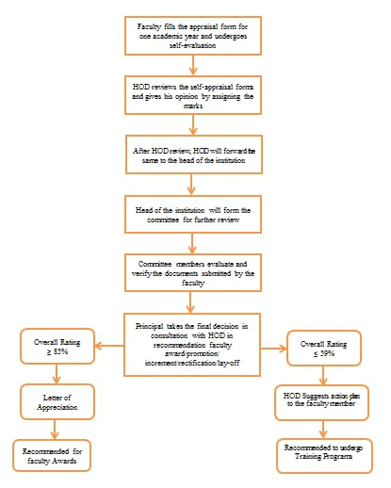
Criterion-5 : Faculty Information & Contribution
The process of performance evaluation is as follows:
    The Faculty fills the appraisal format and submits with necessary documents to the HOD.
    The HOD evaluates and submits it to the committee constituted by the principal for further action.
    The committee consolidates and submits to the Principal for further recommendation.
    The recommendation would be advising the faculty to participate in faculty development programs to enhance knowledge, enhance qualifications, organize programs in the college and submit project proposals to funding agencies.
Faculty List
SFR & Qualification
FCP
Retention
Innovative Tools
FDP
R & D
Self appraisal Process
Self appraisal

Slide 35
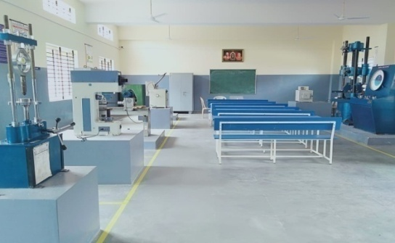
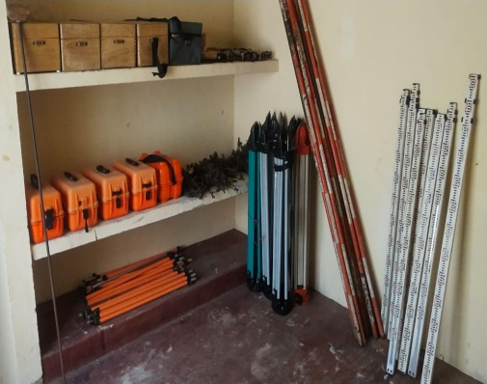
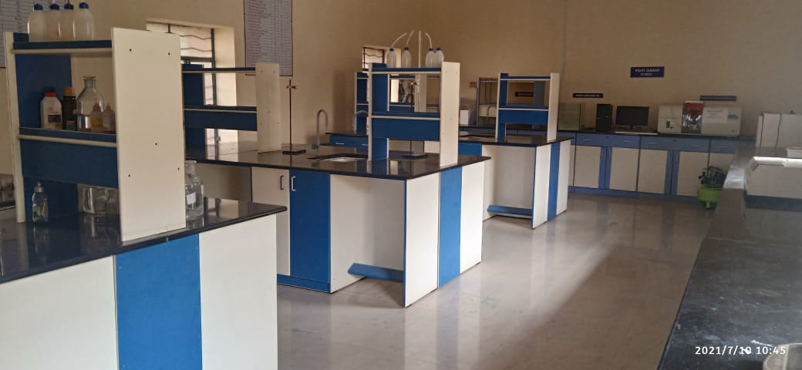
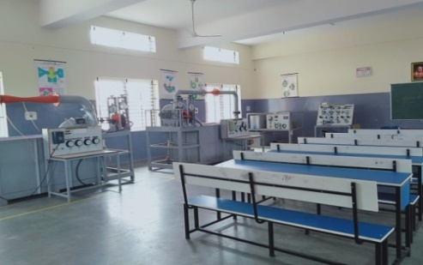
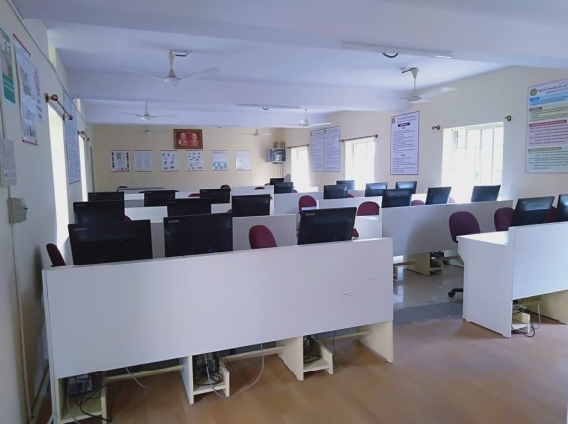
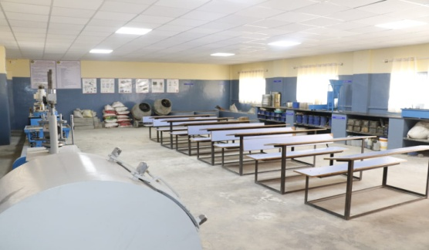
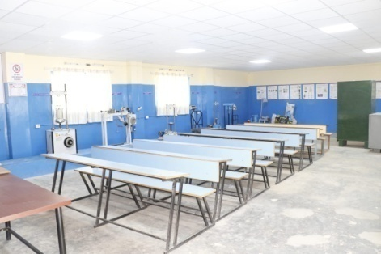
Criterion-6 : Facilities & Technical Support
Teaching Laboratories
Other
facilities
Fluid Mechanics and Hydraulic Machines Laboratory
Carpet area 139Sq m
Material Testing Laboratory
Carpet area 139 Sq m
Surveying Laboratory
Carpet area 66 Sq m
Environmental Engineering Lab
Carpet area 128 Sq m
Concrete and Highway Material Testing Laboratory
Carpet area 128 Sq m
Geotechnical Engineering Laboratory
Carpet area 128 Sq m
CAD Laboratory
Carpet area 120 Sq m

Slide 36
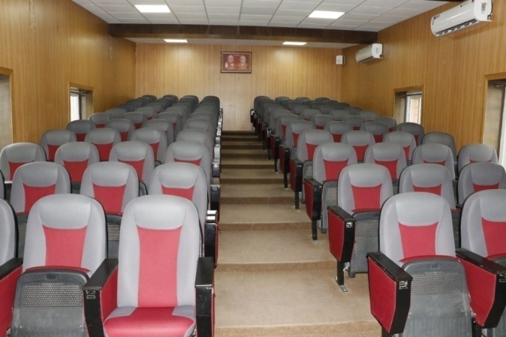
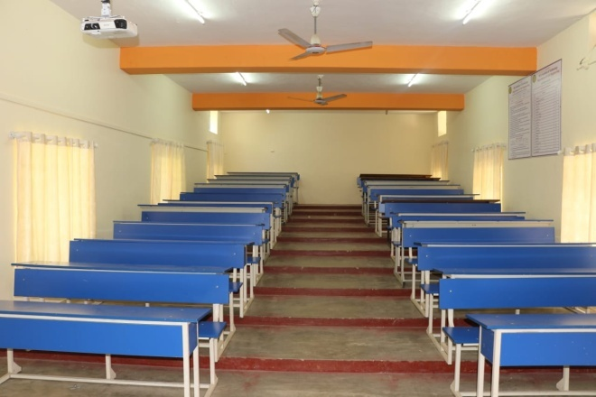
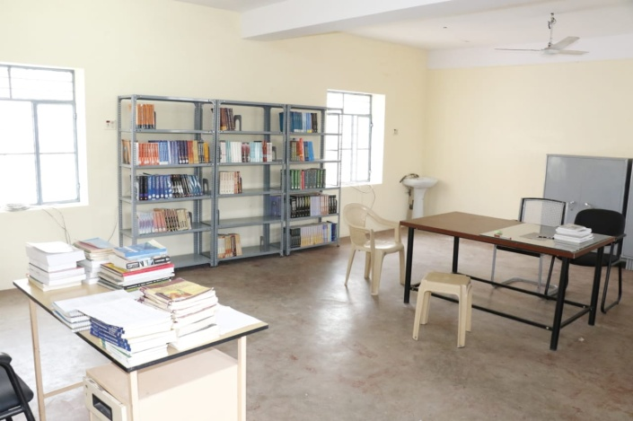
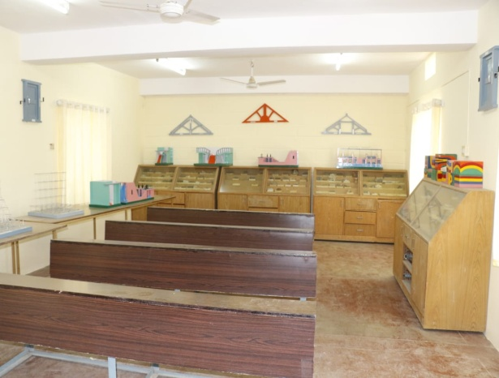
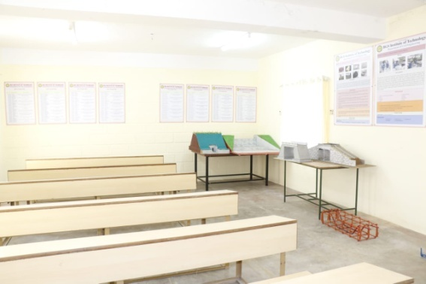


Criterion-6 : Facilities & Technical Support
All the Laboratories are equipped with First Aid Kits.
Fire Extinguishers are placed at the relevant places in the corridors.
All Laboratories are displayed with Do’s & Don’ts boards.
Teaching Laboratories
Other
facilities
Seminar Hall
Class Room
Department Library
Model Room
Project & Research Lab
Safety Measures

Slide 37
Criterion-7 : Continuous Improvement
2017-18 Batch
 | PO1 | PO2 | PO3 | PO4 | PO5 | PO6 | PO7 | PO8 | PO9 | PO10 | PO11 | PO12 | PSO1 | PSO2 | PSO3
Mapped Value | 2.67 | 2.24 | 1.93 | 1.76 | 1.62 | 1.84 | 1.41 | 2.08 | 1.76 | 2.05 | 1.7 | 1.53 | 2.07 | 1.8 | 1.64
Target( %) | 75 | 75 | 75 | 75 | 75 | 75 | 75 | 75 | 75 | 75 | 75 | 75 | 75 | 75 | 75
Attained values | 1.97 | 1.72 | 1.72 | 1.6 | 1.57 | 1.47 | 1.35 | 1.68 | 1.67 | 1.76 | 1.58 | 1.32 | 1.73 | 1.56 | 1.52
Attained (%) | 74 | 77 | 89 | 91 | 96 | 80 | 96 | 80 | 95 | 86 | 93 | 86 | 83 | 87 | 93
2018-19 Batch
Mapped Value | 2.73 | 2.38 | 2.11 | 1.83 | 1.96 | 1.62 | 1.51 | 1.49 | 1.63 | 1.81 | 1.78 | 1.50 | 2.15 | 1.84 | 1.64
Target( %) | 80 | 80 | 80 | 80 | 80 | 80 | 80 | 80 | 80 | 80 | 80 | 80 | 80 | 80 | 80
Attained values | 2.08 | 1.86 | 1.72 | 1.60 | 1.72 | 1.47 | 1.42 | 1.46 | 1.52 | 1.65 | 1.63 | 1.40 | 1.75 | 1.56 | 1.51
Attained (%) | 76 | 78 | 81 | 87 | 88 | 91 | 94 | 98 | 94 | 91 | 92 | 93 | 82 | 85 | 92
2019-20 Batch
Mapped Value | 2.74 | 2.39 | 2.11 | 1.83 | 1.99 | 1.61 | 1.47 | 1.52 | 1.7 | 1.83 | 1.82 | 1.52 | 2.25 | 1.84 | 1.63
Target( %) | 80 | 80 | 80 | 80 | 80 | 80 | 80 | 80 | 80 | 80 | 80 | 80 | 80 | 80 | 80
Attained values | 2 | 1.81 | 1.72 | 1.6 | 1.68 | 1.47 | 1.42 | 1.46 | 1.51 | 1.62 | 1.58 | 1.38 | 1.74 | 1.56 | 1.43
Attained (%) | 73 | 76 | 81 | 87 | 85 | 91 | 96 | 96 | 89 | 89 | 87 | 91 | 77 | 85 | 88
PO PSO
Attainment
Academic Audit
Quality improvement
Opening and closing rank

Slide 38
POs Attainment Levels and Actions for Improvement (2018-2019)
Criterion-7 : Continuous Improvement
POs/PSOs | Target(%) | Attained(%) | Result
PO1 | 80 | 76 | NA
PO2 | 80 | 78 | NA
PO3 | 80 | 81 | A
PO4 | 80 | 87 | A
PO5 | 80 | 88 | A
PO6 | 80 | 91 | A
PO7 | 80 | 94 | A
PO8 | 80 | 98 | A
PO9 | 80 | 94 | A
PO10 | 80 | 91 | A
PO11 | 80 | 92 | A
PO12 | 80 | 93 | A
PSO1 | 80 | 82 | A
PSO2 | 80 | 85 | A
PSO3 | 80 | 92 | A
PO PSO
Attainment
Academic Audit
Quality improvement
Opening and closing rank

Slide 39
Criterion-7 : Continuous Improvement
POs / PSOs | Target % | Attained % | Actions proposed for Improvement
PO1 | 80 | 76 | Additional classes to be conducted to improve the Mathematical fundamental basics and Civil Engineering fundamentals for the courses 15MAT21, 15CV72 and 15CV82. Live Examples and Models are used to demonstrate the concepts of the course 15CV36.
PO 6 | 80 | 91 | Technical talk on challenges in construction is conducted for the professional development for the courses 15CV651,15CV63 and 15CV833.
PSO 3 | 80 | 92 | Students are guided to take online aptitude classes and Extra efforts are made by the institution for giving training programs which helps to boost the knowledge, technical skills and professional growth. 2. Fundamentals of the courses like 15PCD23 and 15CPL26 are practiced thoroughly which helps the student in seeking opportunities in industries. 3. Experts from the construction industries are given lecture about basic ideas and current opportunities with respect to the courses like 15CV44 and 15CV52.
PO PSO
Attainment
Academic Audit
Quality improvement
Opening and closing rank
POs Attainment Levels and Actions for Improvement (2018-2019)

Slide 40
Criterion-7 : Continuous Improvement
External academic audit
Internal academic audit
PO PSO
Attainment
External Academic audit
The internal academic audit will be done once in a semester and give their feedback:
The Internal audit committee members are
  Principal
  Academic in charge of the Institute
  Head of the department
  Senior faculty from other department
AICTE
Academic Audit
LIC
Principal
Quality improvement
YES
All Departments
If any deficiency compliance
Opening and closing rank
Academic and Administrative audit of the department are conducted by Internal Quality Assurance Cell to monitor the quality of teaching learning process and continuous improvement.
NO
Continuation of Affiliation

Slide 41
Criterion-7 : Continuous Improvement
Placement , Higher Studies and Entrepreneurship
PO PSO
Attainment
Item | CAYm1 (2019-20) | CAYm2 (2018-19) | CAYm3 (2017-18)
Total no. of final year students (N) | 67 | 55 | 62
No. of students placed in Companies or Government Sector(X) | 28 | 28 | 30
No. of students admitted to higher studies with valid Qualifying scores. (Y) | 6 | 0 | 4
No. of students turned entrepreneur in engineering / Technology (Z) | 0 | 1 | 2
Placement Index (X+Y+Z) / N | 0.50 | 0.53 | 0.58
Average placement | 54%
Academic Audit
Quality improvement
Opening and closing rank

Slide 42
Criterion-7 : Continuous Improvement
Quality of Student Admission
PO PSO
Attainment
ITEM |  | CAY (2020-21) | CAYm1 (2019-20) | CAYm2 (2018-19)
CET State/University/Level Entrance Examination /Other | No. of Students admitted | 14 | 21 | 27
 | Opening Rank | 50580 | 30054 | 36570
 | Closing Rank | 128000 | 210853 | 135283
DIPLOMA CET Name of the Entrance Examination for Lateral entry or lateral entry details | No. of Students admitted | 02 | 02 | 11
 | Opening Rank | 6680 | 2110 | 4200
 | Closing Rank | 6838 | 3159 | 9259
Average CBSE/Any other Board Result of admitted students (Physics, Chemistry & Maths) PU Students |  | 68% | 66% | 64%
Academic Audit
Quality improvement
Opening and closing rank

Slide 43
Criterion-7 : Continuous Improvement
CET Opening & Closing Rank
PO PSO
Attainment
Academic Audit
Quality improvement
Opening and closing rank

Slide 44
Outcome Based Education
Framework for Outcome Based Education
Institute Vision and Mission
Washington Accord
Program Outcomes
Teaching Learning & Evaluation
Department Vision and Mission
Course Outcomes
Program
Program Educational Objectives
Graduate Engineer

Slide 45
Outcome Based Education
Outcomes based education (OBE) is a process that involves the restructuring of curriculum, assessment and reporting practices in education to reflect the achievement of high order learning and mastery rather than the accumulation of course credits”
OBE involves the restructuring of curriculum, assessment and reporting practices in education to reflect the achievement of high order learning and mastery rather than accumulation of course credits.
  Benefits of OBE:
  More directed & coherent curriculum.
  Graduates will be more “relevant” to industry & other stakeholders (more well rounded graduates)
  Continuous Quality Improvement (CQI) is in place.

Slide 46

Outcome Based Education
OBE Measuring Process
Program & Course Outcomes
Program Education Outcomes
Input
Process
Teaching Staff
Curriculum
Labs
Other Resource
Teaching &
Learning
Students at
Graduation
Graduates
to Fulfill
Stakeholders’
Satisfaction
Assessment by exam, test and assignments.
Assessment of teaching staff, lecture material & flow, results and student ‘capabilities’ (Short & long-term outcomes), lab interview, exit survey etc.
More ‘thinking’ projects, with analysis.
Feedback from industry, alumni and other stakeholders.
Clear continuous improvement step.
Stakeholders

Slide 47
Outcome Based Education
Approach of OBE
Identifying Desired Outcomes
Determining assessment measures for the achievements of Outcomes
Deciding on strategies and methodologies to achieve those outcomes

Slide 48
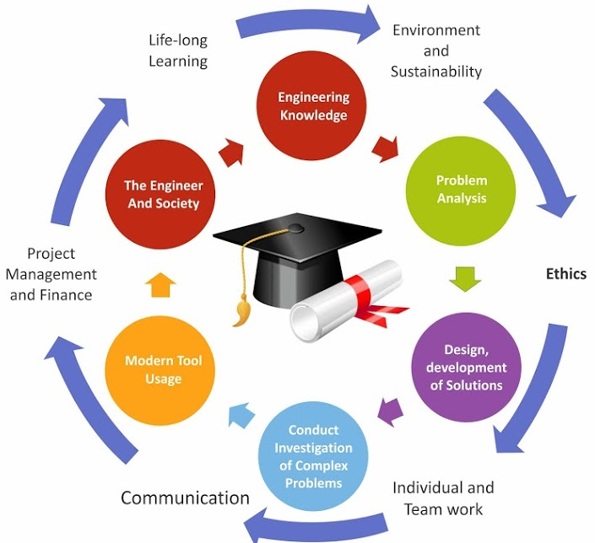
Outcome Based Education
Graduate Attributes

Slide 49
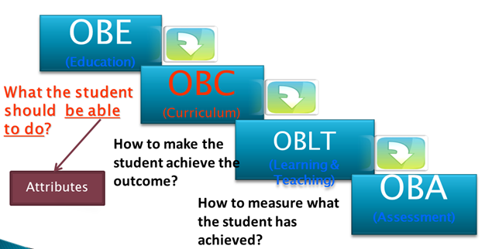
Outcome Based Education
(Education)
(Curriculum)
(Learning & Teaching)
(Assessment)

Slide 50
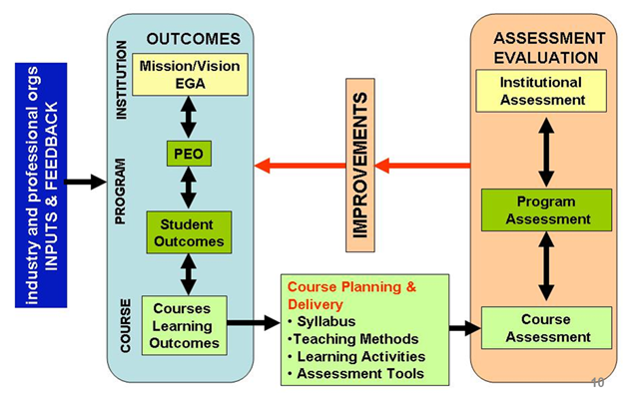
Outcome Based Education
OBE Framework
Vision/Mission

Slide 51
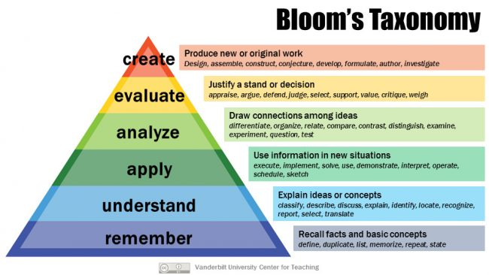
Outcome Based Education

Slide 52
Outcome Based Education
Students Under OBE
Students are expected to be able to do more challenging tasks other than memorize and reproduce what was taught.
Students should be able to: write project proposals, complete projects, analyze case studies, give case presentations, show their abilities to think, question, research, and make decisions based on the findings.
Be more Creative, able to analyze and Synthesize information.
Able to plan and organize tasks, able to work in team as a community to propose solutions to problems and market their solutions

Slide 53
Outcome Based Education
Administration System for Implementation of OBE
Course Co-ordinator
Module Coordinator
Programme Coordinator
Programme Assessment Committee
Department Advisory Board
Internal Quality Assurance Cell (IQAC)

Slide 54
Outcome Based Education
Process for defining department Vision and Mission statements
Established Standards
BGSIT
Vision and Mission Statements
SWOT Analysis
Inputs from HOD and Faculties
Department
Vision and Mission Statements Prepared By HOD
Stakeholders Inputs
PAC reviews the draft of Department Vision and Mission Statements
Review of Vision and Mission by DAB for Approval
Not Approved
(Incorporate Suggestion)
Approved
Approval by Head of the Institution
Publishing, Dissemination and Awareness of Department Vision and Mission statements to all the Stakeholders

Slide 55
Outcome Based Education
Process for defining Program Educational Objectives (PEOs)
Vision and Mission of the Institution
Draft of Program Educational Objectives (PEOs) prepared by HOD
Program Outcomes
Vision and Mission of the Department
SWOT Analysis
Stakeholders Input
Review and Refining of PEOs by PAC
Review of PEOs by DAB for Approval
Not Approved
(Incorporate Suggestion)
Approved
Finalize PEOs
Publishing, Dissemination and Awareness of PEOs
to all the stake holders.

Slide 56
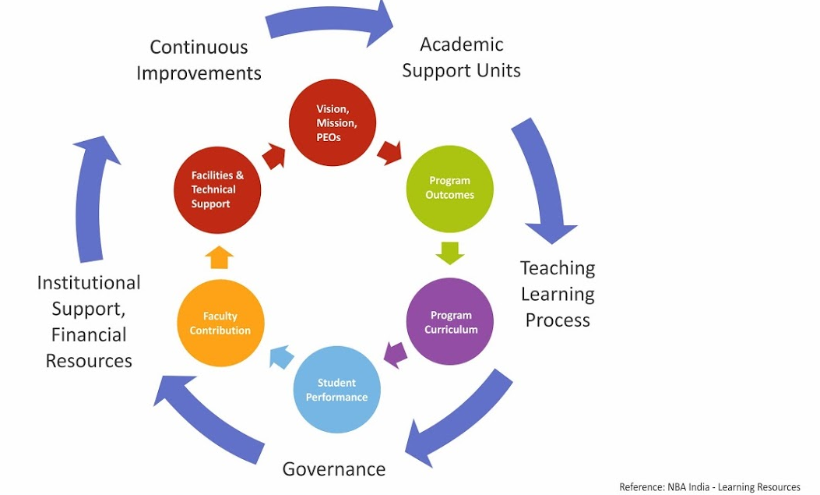
Outcome Based Education
Quality Assurance

Slide 57
Outcome Based Education
Continuous Quality Improvement (CQI)
Assessment
Assessment
Assessment
Analysis
Analysis
Analysis
Stakeholders’
Mission & Vision
Program Educational Objectives
Program Outcomes
Course Outcomes
CQI
CQI
CQI

Slide 58
Outcome Based Education
Problem Analysed for Project Work in OBE
Literature
Lectures
Group Studies
Problem Analysis
Problem Solving
Report
Tutorials
Field Work
Experiment

Slide 59
Outcome Based Education
Best Practices in Department
Curriculum Gap Analysis and Planning, students’ project work will be reviewed periodically
Tutorial Classes are conducted
Student Performances are monitored and analysed regularly through Proctoring System
Student Centric Activities are done regularly
Content Beyond Syllabus through Seminars, Flipped class, Project based learning, Workshops, Technical Talks, Industrial Visits, Regular aptitude and communication skill training are conducted.
Student Feedback System (Mid of the Semester – Offline and
End of the Semester – Online) is followed

Slide 60
Outcome Based Education
Best Practices in Department
MOUs with industries are executed and activities are conducted
Student Co-curricular and extra curricular activities are encouraged
Encouraging Bright Students in the Department
Peer Review of Teaching
Counselling for Faculty Members
Entrepreneurship Development Cell

Slide 61
Outcome Based Education
Conclusion
OBE is student focus and Improved learning process.
That change will require learning opportunities for teachers that reinforce and expand their knowledge
Increased in institutional effectiveness
Enhanced accountability in Teaching and Learning process
Quality education
Develop measurable & linked
  Program/course learning outcomes
  Program Educational Objectives
  assessment & evaluation
Teachers' Learning will be a valuable resource for classrooms, departments, and professional organizations

Slide 62
Outcome Based Education
Thank You

